Slide 1
AQS Users Tribal Q&A Session
September 10, 2014

Slide 2
Agenda
Do you have any questions?
‘How To’ Series:
How to create Site online (quick review)
How to create a Monitor Online - demo
How to duplicate a Monitor Online – demo
Tips for duplicating a Monitor
Notes:
Here is our agenda.

Slide 3
‘How to’ Series Review…
How to create a Site

Slide 4
How to Create a Site
Create Site via.…
Online Maintenance
Maintenance>Site
Batch
Delimited text file
XML file
Can use the AMP500 report to duplicate an existing site and create transactions in XML or Delimited text file format
Notes:
You can create a site online or in Batch. For Batch you can use a delimited or XML file.

Slide 5
Some things you may need….
Print AQS Site form and fill out beforehand
Your Tribal Code as designated by the AQS Team
Your chosen site id – see site info slide
AQS Data Coding Manual for reference
Contact information of person who set up site
Contact information for your AQS Regional Representative
http://www.epa.gov/ttn/airs/airsaqs/AQSROContacts.pdf

Slide 6
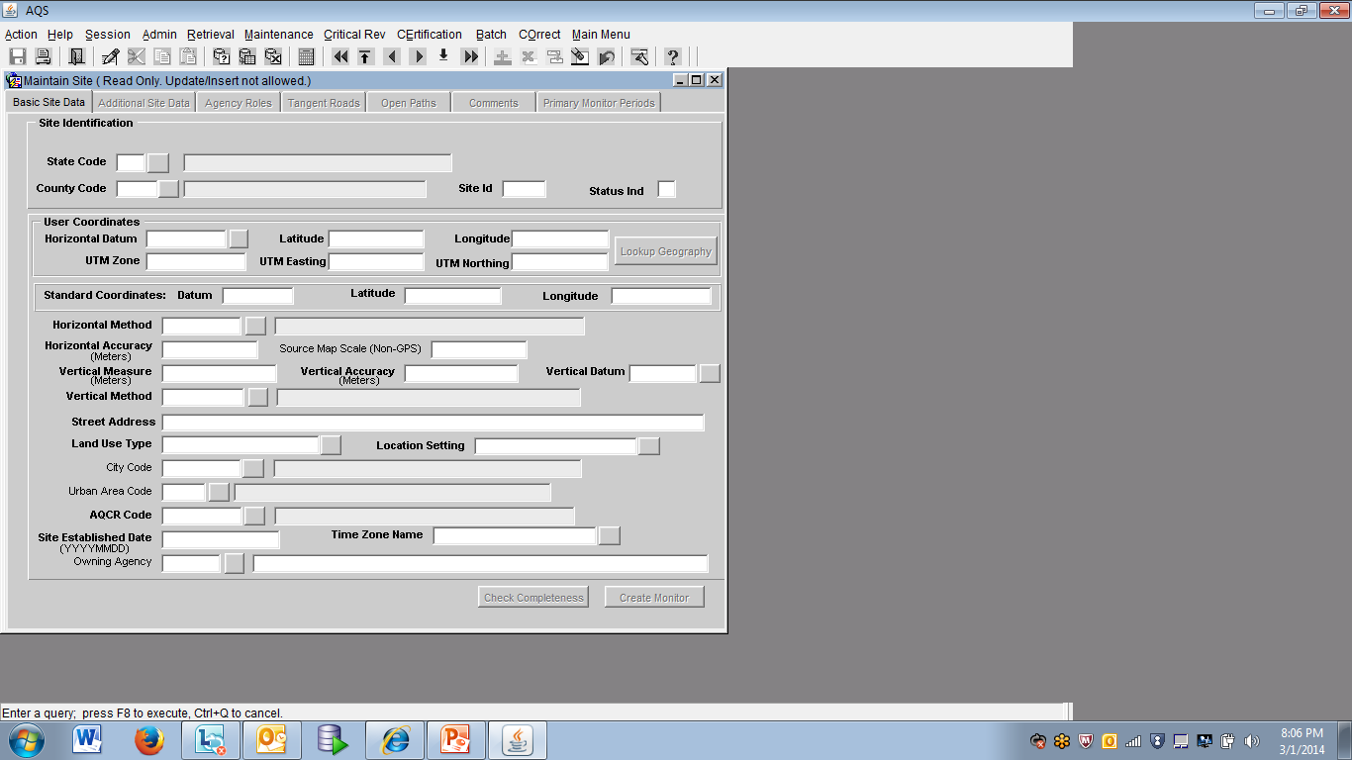
Notes:
Here is the AQS Online Site Form. Print this slide or take a screen shot of the screen in AQS and obtain this information prior to accessing AQS. This is information that the person who sets up the site will have.
You will also need to determine your site id.

Slide 7
Site Id
A numeric identifier (ID) that uniquely identifies each air monitoring site within a county or tribal area. There is no requirement that Site IDs be assigned continuously or in any particular order. Regional and Local organizations are thus free to allocate site numbers in any way they chose as long as there is no duplication within a county and tribal area. For Tribal sites, because tribal areas may cross county or state lines, care must be taken to ensure that the Site ID is unique in the effected Tribal Area and states-county.
A specific Site ID is associated with a specific physical location and address. Any change in address requires a new Site ID to be assigned. This address change could include a change from the roof of one building to another. A change in location on the same roof should not normally require a new Site ID. Although an address change would routinely mean a new Site ID, some changes that do not change the site's location in respect to surrounding sources and its measurement scale, would require no change. An EPA Regional Office should be consulted for assistance in determining whether a new Site ID is required. If a new Site ID is needed for a site not operated by the air pollution control agency, that agency should be contacted to assist in the ID assignment, to ensure that the ID is unique within the county. In other words, when a new Site ID is assigned, it must be different from any other Site ID already existing for that combination of State and County or Tribal Code
Notes:
Here is some information about the Site ID from the AQS Data Coding Manual.

Slide 8
Site ID attributes
Alphanumeric
4-digit ID
Mandatory
Key Field
Notes:
These are the site id attributes.
2.2.6 Key Fields
Certain mandatory fields are also labeled as “Key” fields. These fields are used to uniquely identify specific data in the database. For example, for a Monitor Sampling Period, the Date Sampling Began, is a key field. It, along with {state, county, site, parameter, and POC} uniquely identifies one row of data in the database. Key fields are always mandatory for all Action Indicators, and key fields cannot be modified by an update transaction.

Slide 9
Steps for inputting a site via online Maintenance
Access AQS. If not in Tribal Mode, access Tribal Mode.
Access your screening group.
Go to Maintenance > Site and you should be placed on the Basic Site Data tab
On the Basic Site Data tab, click on your Cancel Query button to access input mode
Enter your tribal code
Enter state code
Enter your county code
Do not enter anything in the Status Ind
Enter Horizontal Datum
Enter Latitude/Longitude -OR- UTM Zone/UTM Easting/UTM Northing.
Click on Lookup Geography. Note the Standard Coordinates get populated.

Slide 10
Steps for inputting a site via online Maintenance
12. Continue to enter the rest of the required fields (in Bold) on the Basic Site Data tab
13. Optional: Click on the ‘Additional Site Data’ tab and enter any site meta data; else leave blank
14. Required: Click on the Agency Roles tab and enter a Supporting Role and Date
15. Access Tangent Roles tab and specify if your site has one; else leave blank
16. Access Open Paths and specify if your site has one; else leave blank
17. Access Comments tab and specify comment if you want to specify a comment for your site; else leave blank
18. Do not specify anything on the Primary Monitor Periods tab at this point.
19. Go back to the Basic Site Data tab.
20. Click Save.
21. To refresh, re-query your site by clicking on the enter query button. Enter your tribal code and site id, and then click on the Execute Query button. Click on the ‘Check Completeness’ button at the bottom of the Basic Site form and note any errors or missing data to fix. Fix any errors and Save again. Note: until you add your first monitor you will always have one Relational Error (‘To enter a new Site record, you must enter at least one Monitor record’) specified when you click on the Check Completeness button…this should be the only error you have.
22. Your site will have a ‘F’ Status Ind until you add your first monitor at the site. Once you add your first monitor the Site Status Ind will change to ‘P’ (Production)
Notes:
Tangent Roads - The monitor's relationship to nearby streets may be described by using the MG transaction. If either tangent street number or distance from monitor is valued, the other must also be valued. Similarly, one may not be deleted without also deleting the other.
Open Path Number
Description: The specific open path number registered at the site that the monitoring data and monitor represent. The number must be registered at the site before it can be identified by the monitor.
Enter tribal code in addition to the state , county and site. This will associate the tribal code with your state, county and site.

Slide 11
Tips to Creating a Site Online
A lot of the information on the Basic Site Data tab comes from whomever set up your site. Try to obtain this information before you begin inputting your site data in AQS, else you will not be able to finish. You can print the Basic Site Data screen in AQS beforehand and fill it out.
Obtain your Tribal Code from your AQS Regional Representative or the AQS Team.
You determine your site id. Review the sites you already have in AQS and decide upon a site or consult your regional representative regarding a Site Id
To create a site you access Maintenance>Site
Be sure to click on the Cancel Query button to access input mode before you start inputting your site data
Everything in bold on the Basic Site Data tab is required
After you enter the information on the Basic Site Data tab up to and including the UTM –or- Lat/Long, click on the Lookup Geography button to populate the standard coordinates.
The Agency Roles Tab>Supporting Roles is Required
Information is only required on the Basic Site Data Tab and Agency Roles tabs. The other tabs are site specific and/or optional…or input is required only for certain pollutants (i.e. primary monitor periods tab)
When the Status IND on Basic Site Data Tab changes from ‘F’ to ‘P’ or Production Status your site is complete and you are done (Note: you must add a monitor for the Status to change from ‘F’ to ‘P’). When your site is at ‘F’ Status only you and members of your screening group can see it. When your site is at ‘P’ status everyone can see your site.
Use the AQS Data Coding Manual if your are unsure of any terms on the site form.

Slide 12
Creating a Site via Batch
You can create your site using the site transaction formats noted in the AQS Transactions Formats document or you can also extract data for an existing site in transaction format by generating the AMP500 Extract Site/Monitor Data Standard Report and then edit this information.
If you use the AMP500, be sure to deselect the monitor transactions on the Report Options tab. After you generate the report, download the text file to your machine
Edit the file in notepad (or other editor) –or- you can send file to AQS>Stage and edit the file in Correct
Load file (you do not need to explicitly Post site transactions)
In AQS, your site will remain at ‘F’ status till you create your first monitor at the site
Notes:
Basic site and additional site data in on AA transaction

Slide 13
‘How to’ Series
How to create a Monitor

Slide 14
Note: A monitor id consists of the
State – county –site – parameter – poc
or
Tribal Code – site – parameter - poc

Slide 15
How to Create a Monitor
Create Monitor via.…
Online Maintenance
Maintenance>Monitor
Batch
Delimited text file
XML file
Can use the AMP500 report to duplicate an existing site and create transactions in XML or Delimited text file format
Notes:
You can create a monitor online or in Batch. For Batch you can use a delimited or XML file.

Slide 16
Creating a Monitor via Online Maintenance
Access Maintenance>Monitor
Click on your ‘Cancel Query’ icon
Enter your Tribal Code and Site ID
To activate tabs on the right, tab to one of the fields at the bottom of the Monitor Basic screen such as; project class, meas scale, etc.
Click on Sample Period tab – add sample period YYYYMMDD
Click on Type Assignment – Choose ‘Tribal’ Monitor Type and add begin date
Click on Agency Roles Tab – Add ‘Analyzing’, ‘Collecting’, ‘Reporting’, ‘PQAO’, and ‘Certifying’ Roles along with their corresponding ‘Agency Code’ and ‘Begin Date’
Click on Objectives Tab – Choose your ‘Monitor Objective Type and choose either UA, CBSA or CSA Represented. Note you can have more than one Objective specified.
Click on Required Frequencies Tab. If your pollutant requires a frequency add it here with the date.
Click on Methods Tab – Choose Monitor Method and specify the begin date. Note this method must match the method you have specified in your data records.
The rest of the tabs are optional. If they apply to your monitor, then be sure to specify information on those tabs

Slide 17
Tips for creating Monitor Online
Make sure to click on your ‘cancel query’ button first. This will put you in input mode.
To enable all the tabs on the right of the screen, tab to the Monitor Meta data at the bottom of the screen and the tabs on the right should become active.
Enter appropriate information on monitor tabs (i.e. sampling period, agency roles, etc.) and Save.
The Method must be specified on the Method Form.
Make sure monitor status changes from ‘F’ to‘P’ (Production) status when you click on Save.
Notes:
Enter Monitor data on the applicable active tabs and save.

Slide 18
Tips for duplicating a monitor
You can only duplicate monitors which are under the same site
Query for monitor you want to duplicate, then click on the ‘duplicate monitor’ button.
If Parameter and/or POC is different, enter it in the popup you receive after clicking on duplicate monitor button.
Sample Schedules are only duplicated when the collection frequency code is 8, 9, or S. Click on ‘OK’ when receive this popup
If you plan to make changes to the monitor (i.e. dates), do not commit the changes initially.

Slide 19
Creating a Monitor via Batch
You can create your site using the monitor transaction formats noted in the AQS Transactions Formats document or you can also extract data for an existing site in transaction format by generating the AMP500 Extract Site/Monitor Data Standard Report and then edit this information.
If you use the AMP500, be sure to deselect the site transactions on the Report Options tab. After you generate the report, download the text file to your machine
Edit the file in notepad (or other editor) –or- you can send file to AQS>Stage and edit the file in Correct
Load file (you do not need to explicitly Post site transactions)

Slide 20
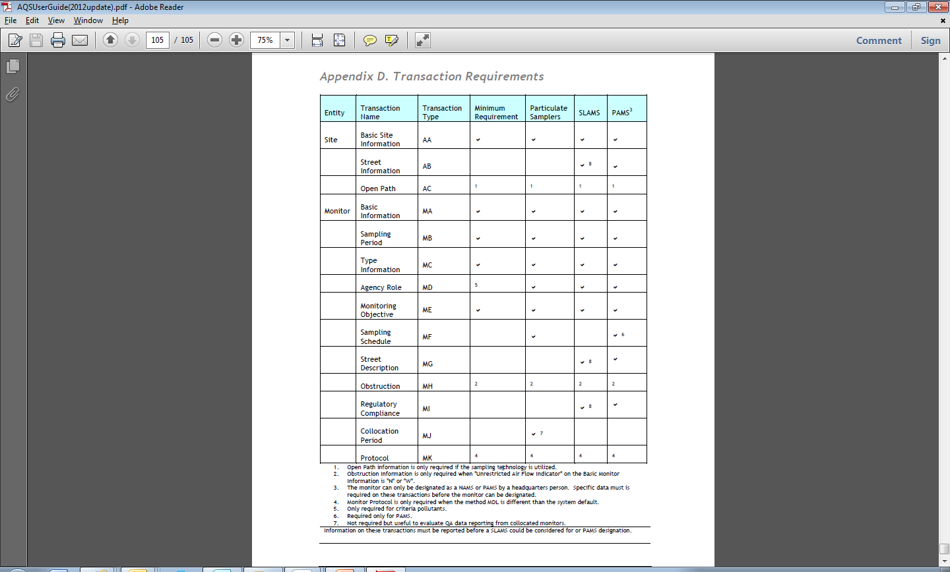
Monitor Requirements can be found here
Notes:
From Old AQS Manual
Request AQS Team – add to website

Slide 21
Resources…
AQS User’s Guide:
http://www.epa.gov/ttn/airs/airsaqs/manuals/docs/users_guide.html
AQS Input Transaction Formats:
http://www.epa.gov/ttn/airs/airsaqs/manuals/AQS%20Input%20Transaction%20Formats%20v2_17.pdf
AQS Data Coding Manual:
http://www.epa.gov/ttn/airs/airsaqs/manuals/AQS_Data_Coding_Manual.pdf
Air Monitoring Methods:
http://www.epa.gov/ttn/amtic/methods.html

Slide 22
Demo
Site 927-071-9050, Kaw Nation
Monitor 927-9050-44201-1
Monitor duplicate
927-9050-68104-1,68104-2

Slide 23
Thank you for attending!

